Slide 1


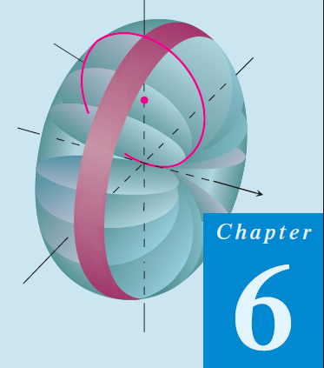
Thomas Calculus 11th
10
Integration Applications
Samuel Lukas

Slide 2
Agenda
Area Between Curves
Differential Equation
Art Length
Area of a surface of revolution
Volumes by Slicing
Revolution: The Disk Method
Revolution: The Washer Method
Volumes by Cylindrical Shells

Slide 3


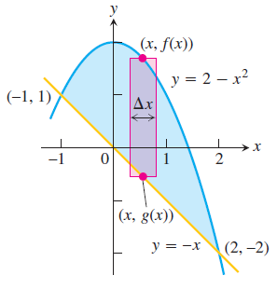
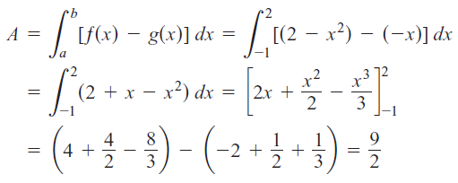
Area Between Curves

Slide 4
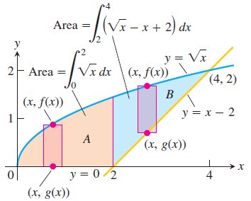
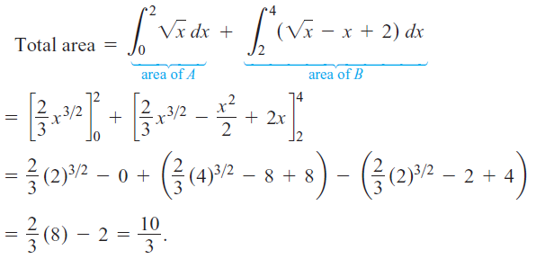
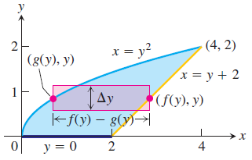
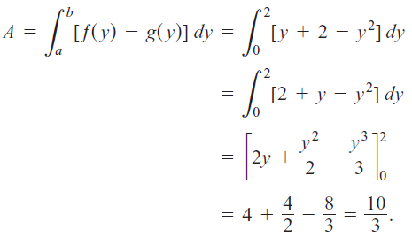

$$\sqrt{x}=x−2 → x=1, x=4$$

Slide 5
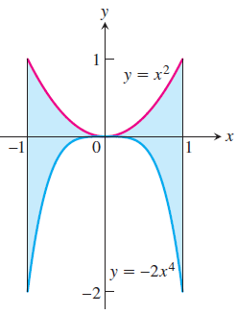
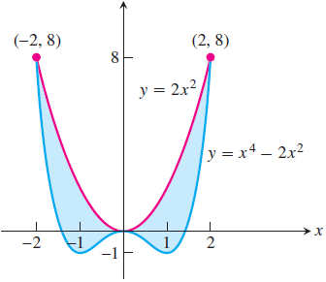
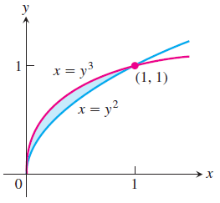
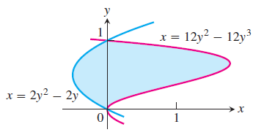
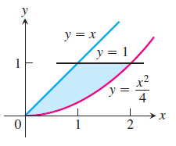
Exercises 1
Find the total areas of the shaded regions

Slide 6
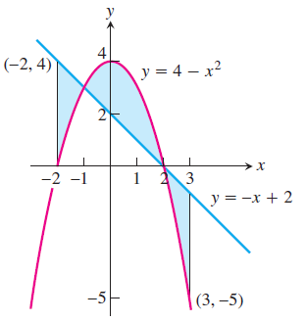
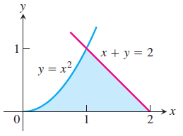
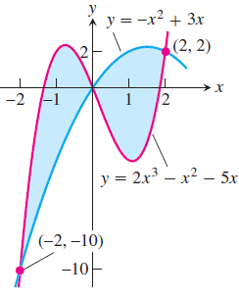
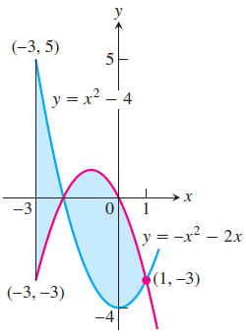
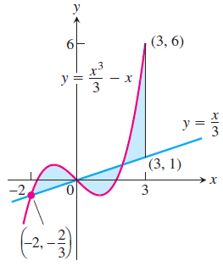

Slide 7








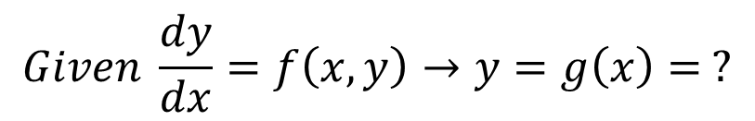
Differential Equation
$$Given \frac{dy}{dx}=f\left(x,y\right)→y=g\left(x\right)= ?$$

Slide 8
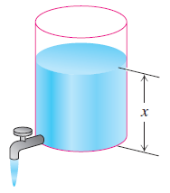










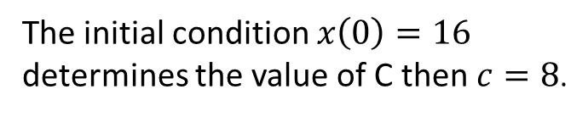

So, the problem is
The initial condition $x\left(0\right)=16$
determines the value of C then $c=8$.
Tank will empty V = 0 in $t=400π$ minutes, which is about 21 hours.

Slide 9









Exercises 2
Solve the differential equation in Exercises 1 – 9
01
02
03
04
05
06
07
08
09

Slide 10
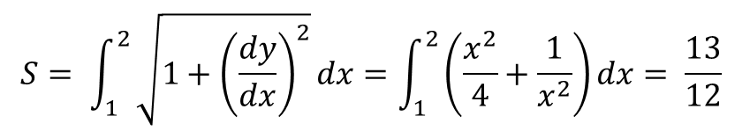
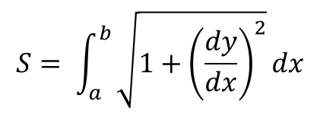
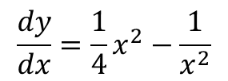
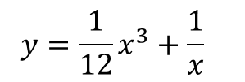
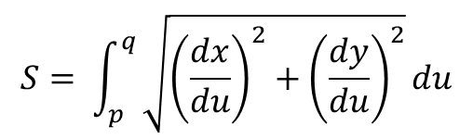
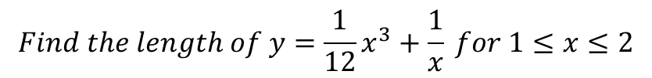
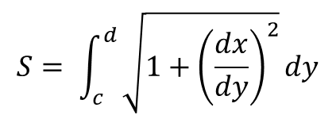
Art Length
$$We would like to measure the art length of y=f\left(x\right) from a≤ x≤b$$
$$S= \int_{a}^{b}{\sqrt{1+{\left(\frac{dy}{dx}\right)}^{2}}dx}$$
$$S= \int_{c}^{d}{\sqrt{1+{\left(\frac{dx}{dy}\right)}^{2}}dy}$$
$$S= \int_{p}^{q}{\sqrt{{\left(\frac{dx}{du}\right)}^{2}+{\left(\frac{dy}{du}\right)}^{2}}du}$$
$$Find the length of y=\frac{1}{12}x^{3}+\frac{1}{x} for 1≤x≤2$$
$$y=\frac{1}{12}x^{3}+\frac{1}{x}$$
$$\frac{dy}{dx}=\frac{1}{4}x^{2}−\frac{1}{x^{2}}$$
$$∴1+{\left(\frac{dy}{dx}\right)}^{2}=1+{\left(\frac{x^{4}−4}{4x^{2}}\right)}^{2}=\frac{x^{8}−{4x}^{4}+16}{16x^{4}}={\left(\frac{x^{2}}{4}+\frac{1}{x^{2}}\right)}^{2}$$
$$S= \int_{1}^{2}{\sqrt{1+{\left(\frac{dy}{dx}\right)}^{2}}dx=\int_{1}^{2}{\left(\frac{x^{2}}{4}+\frac{1}{x^{2}}\right)dx= \frac{13}{12} }}$$

Slide 11
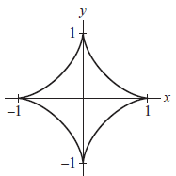








Slide 12





Exercises 3
Find the length of the entire curve or indicated arc
01
$$6xy=x^{4} 1≤x≤8$$
02
$$y=ln⁡(\cos\left(x\right)) π/6≤x≤π/4$$
$$y=ln\frac{e^{x}−1}{e^{x}+1}x^{4} 2≤x≤4$$
03
04
$${y=0.5x}^{2}−0.25\ln\left(x\right) 1≤x≤e$$
05
$$x=a cosθ, y=a sinθ$$
06
$$x=e^{t} cost, y=e^{t} sint 0≤t≤4$$
07
$$x=ln\sqrt{1+t^{2}}, y=\tan^{−1}(t) 0≤t≤1$$
08
$$x=2cos({θ)}+\cos\left(2θ\right)+1, y=2\sin\left(θ\right)+sin⁡(2θ) 0≤θ≤2π$$
09
$$x=θ−\sin\left(θ\right), y=1−cos⁡(θ) 0≤θ≤2π$$

